Slide 1


DETECTION OF STRESS FROM VOICE

Slide 2

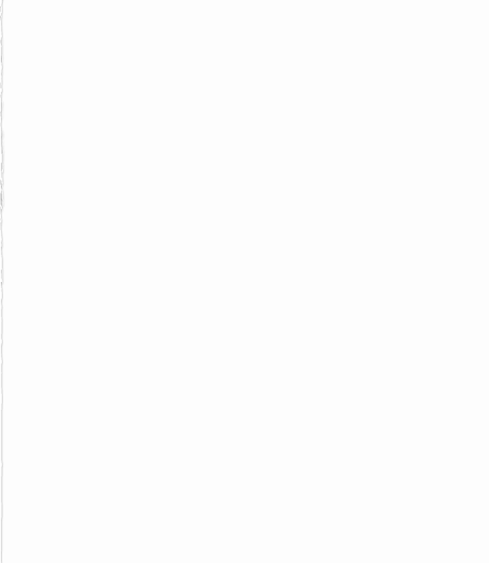
APPROACH
Dataset collection(RAVDESS).
Library files installation.
Feature extraction.
Emotions available in dataset.
Loading the datasets.
Splitting datasets into train and test sets.
Train model .
Accuracy calculation.

Slide 3
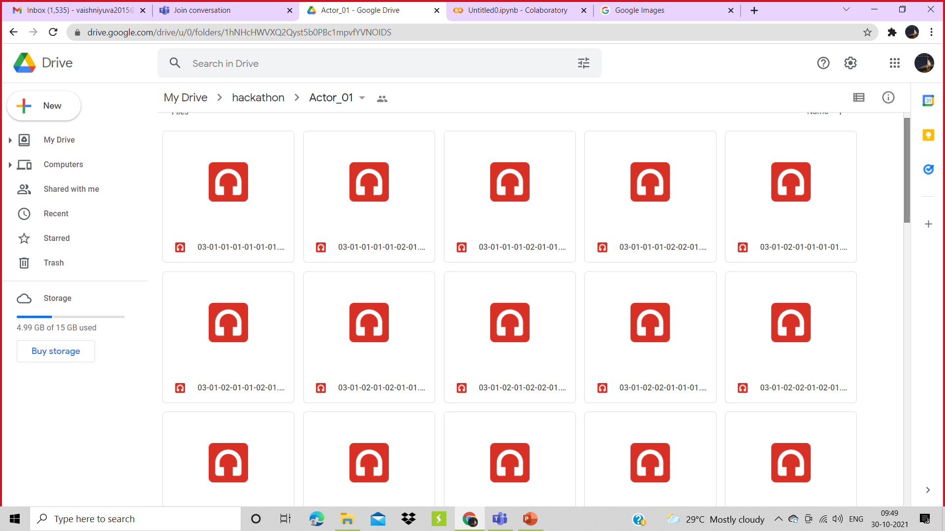
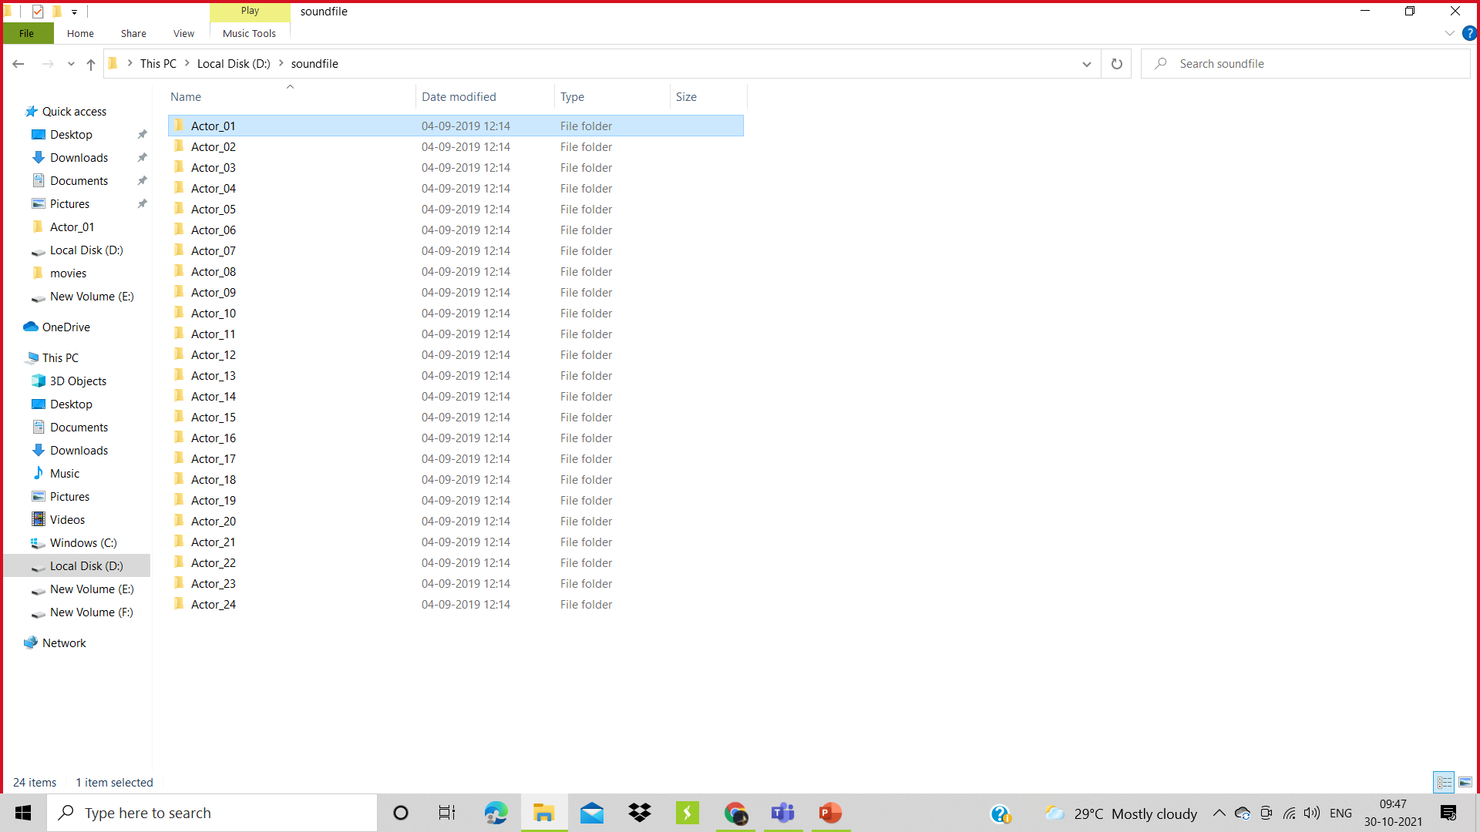
DATASET COLLECTION
Here we are using the RAVDESS dataset Ryerson Audio-Visual Database of Emotional Speech and Song dataset. This dataset has 7356 files rated by 247 individuals 10 times on emotional validity, intensity, and genuineness. The entire dataset is 24.8GB from 24 actors
SOURCE: https://www.kaggle.com/uwrfkaggler/ravdess-emotional-speech-audio

Slide 4
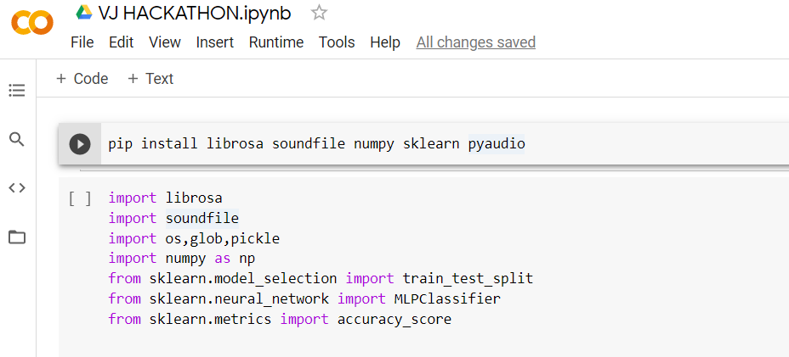
LIBRARY FILES INSTALLATION

Slide 5
librosa is a Python library for analyzing audio and music. It has a flatter package layout, standardizes interfaces and names, backwards compatibility, modular functions, and readable code.
glob() function from the glob module to get all the pathnames for the sound files in our dataset.
NumPy is the fundamental package for scientific computing in Python.

Slide 6
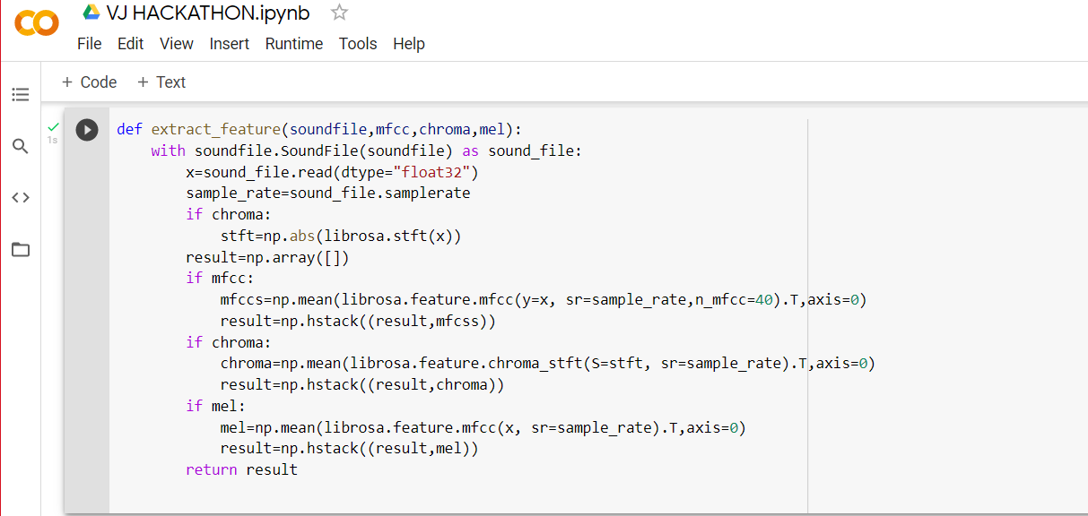
FEATURE EXTRACTION

Slide 7
We are defining a function extract_feature to extract the mfcc, chroma, and mel features from a sound file.
mfcc: Mel Frequency Cepstral Coefficient, represents the short-term power spectrum of sound.
chroma: Pertains to the 12 different pitch classes.
mel: Mel Spectrogram Frequency
Open the sound file with soundfile.SoundFile and raed from it and get the sample rate.
If chroma is True, get the Short-Time Fourier Transform (stft) of X.
Let the result be an empty numpy array.
Now, for each feature , if it exists, make a call to the corresponding function from librosa and get the mean value.
Call the function hstack() from numpy with result and the feature value.

Slide 8
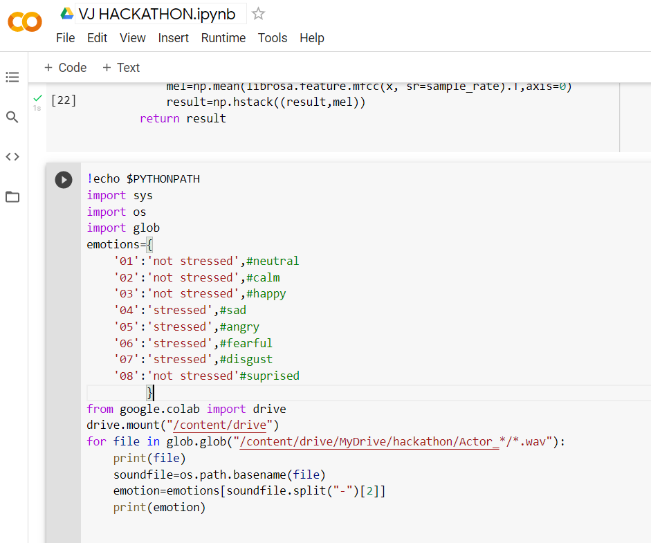
STRESS CLASSIFICATION IN AVAILABLE DATASET

Slide 9
LOADING AND CLASSIFYING

Slide 10
We mounted the dataset on to the drive and loaded .
Using emotions dictionary the numbers in the file name is classified into the desired emotion.
Based on the emotions we are classifying as stressed and not stressed.

Slide 11
